Slide 1
Recommendation Report on Using Wind Energy or Solar Energy
ENGI2304
Yuxuan Zhang

Slide 2
Preview
Introduction
Data and Analysis
Conclusion
Word Cited

Slide 3
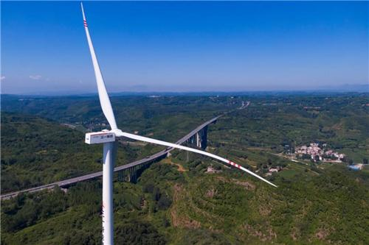
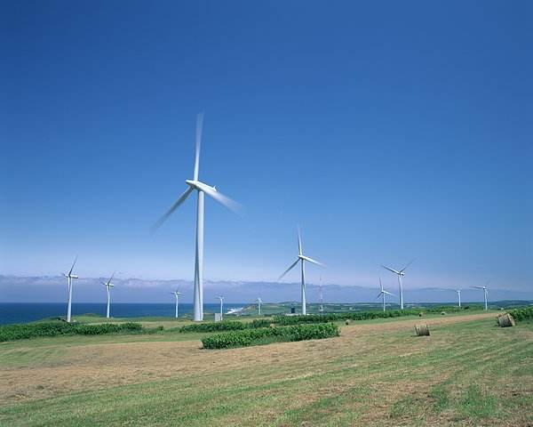
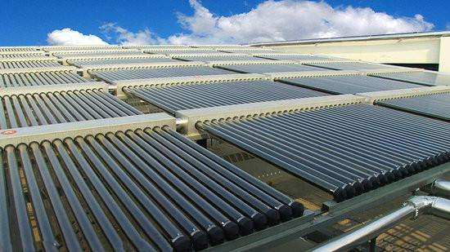
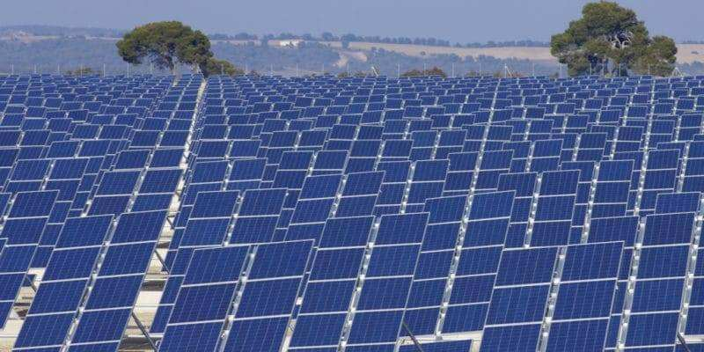
Introduction

Slide 4
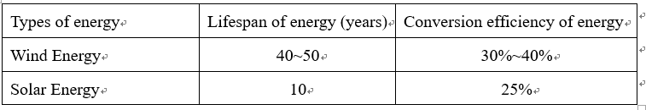
Data and Analysis
Economic Efficiency
Table 1. Data are from Work Cited

Slide 5
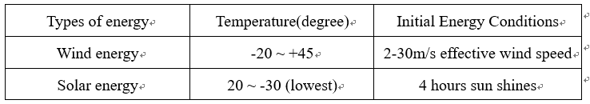
Data and Analysis
Objective Conditions of Use
Table 2. Data are from Work Cited

Slide 6
Conclusion
Summary

Slide 7
Conclusion
Recommendation

Slide 8
Contact
If you have any questions about this report.
Please contact me via email. (17702439521zyx@dlmu.edu.cn)

Slide 9
Work Cited
https://news.bjx.com.cn/html/20210609/1157375.shtml
https://m.quanjing.com/imginfo/hokkaido50021921.html
http://www.youboy.com/
http://www.nengyuanjie.net/article/35799.html
https://baijiahao.baidu.com/s?id=1721210493287987577&wfr=spider&for=pc
https://baijiahao.baidu.com/s?id=1706680328727396515&wfr=spider&for=pc
https://www.sohu.com/na/437590356_120930212
https://www.maigoo.com/goomai/84504.html
https://zhidao.baidu.com/question/109300043.html
https://www.xny365.com/zhuanjia/article-487345.html

